Slide 1
Java Annotations

Slide 2
Objectives
At the end of this session, you will be able to
Understand annotations
Use predefined annotations
Create custom annotations

Slide 3
Agenda
Understanding Annotations
Pre Annotation Techniques
Standard Annotation
Custom Annotation
Annotation Types
Meta-Annotation

Slide 4


Annotations
So, what is annotation?

Slide 5

Annotations
Annotations in JAVA starts with @ sign
Annotations are like meta-tags
Organized data about the code, embedded
within the code itself.
You can add annotation to your code and apply it to
Package declarations
Type declarations
Constructors
Methods
Fields
Parameters & Variables
NOTE: Annotations are first introduced in Java 5.0

Slide 6
Annotations
Annotations are not part of the program logic
They may be evaluated:
@ compile time by the compiler
@ build / deployment time by annotation processors
@ runtime by the program using reflection
public class AClass extends BClass{
@Deprecated
void oldMethod() {
// do something in an old
}
}
Annotations may be
Built-in annotations
User defined annotations
Syntax
@<Name-of-annotation> [ <parameters> ]

Slide 7
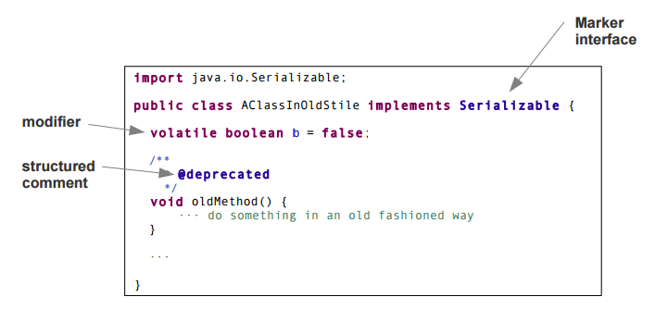
Before Annotations
Pre Java-1.5 annotation techniques:
– marker interfaces
– modifiers
– structured comments
Ad-hoc mix of language elements and programming conventions

Slide 8
Standard Annotations
There are only three types of simple annotations provided by JAVA 5.0
Predefined in java.lang
– @Deprecated
– @Override
– @SuppressWarnings

Slide 9
Standard Annotations
a) @Deprecated
May annotate classes, interfaces, methods
Discourages programmers to use the element
No advantage compared to the structured @deprecated -comment

Slide 10
Standard Annotations
b) @Override
Annotates methods
Indicates that the annotated method overrides a declaration in a super type
Is checked by the compiler
May be used and checked by IDEs

Slide 11
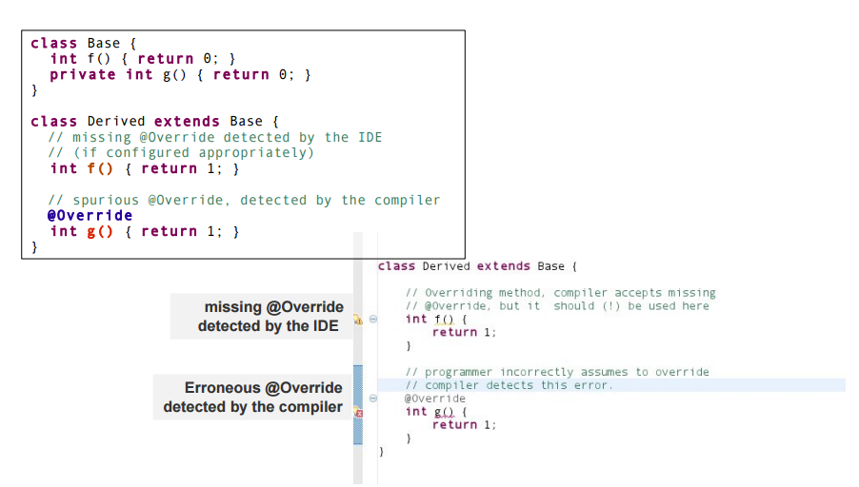
Standard Annotations
b) @Override - Example

Slide 12
Standard Annotations
c) @SuppressWarnings( warning-category )
@SuppressWarnings({ list of warning-categories })
Annotates classes, methods, statements
Indicates that the compiler should suppress within the annotated element all warnings in the warning category or any of the warning categories.
Warning categories
➢ Examples: "all", "deprecation", "unchecked", "serial", ···
➢ General: all warning categories that may be set using
javac -Xlint
may be suppressed using the annotation
(The IDE will handle this)

Slide 13
Standard Annotations
c) @SuppressWarnings - Example
class C {
@SuppressWarnings({"unchecked", "unused"})
private int g() {
List l = new ArrayList();
return 0;
}
}

Slide 14
Standard Annotations
Defined in package javax.annotation
– Java 6 comprises annotations defined in package javax.annotation
@Generated
@PostConstruct
@PreDestroy
@Resource
@Resources
– Intended usage
Enterprise frameworks

Slide 15
Custom Annotations
To create our own custom annotation, we will use an Annotation type
The type is the actual construct used, and the annotation is the specific usage of that type.
An annotation type definition takes an "at" (@) sign, followed by the interface keyword plus the annotation name.
On the other hand, an annotation takes the form of an "at" sign (@), followed by the annotation type.
Copyright © 2016 Tech Mahindra. All Rights Reserved.

Slide 16
Annotation Types
There are three annotation types:
Marker: Marker type annotations have no elements, except the annotation name itself.
Single-Element: Single-element, or single-value type, annotations provide a single piece of data only.
Multi-Value: Full-value type annotations have multiple data members.

Slide 17
Annotation Types
a) Marker Annotation
@interface MyMarkerAnno {
}
@MyMarkerAnno
class annotatedClass {···}

Slide 18
Annotation Types
b) Single-element annotation:
@interface MyValuedAnno {
String value() default "default value";
}
@MyValuedAnno
class annotatedClass1 {···}
@MyValuedAnno(value=“Special value 1”)
class annotatedClass2 {···}
Annotation with one element.
Element may have default value
Element definitions look like parameterless methods

Slide 19
Annotation Types
b) Single-element annotation with array values
@interface MyMultiValuedAnno {
String[] value() default {“default string”,”42”};
int val2() default 42;
}
@MyMultiValuedAnno
class annotatedClass1 {···}
@MyMultiValuedAnno("Hello", “11”)
class annotatedClass2 {···}
Annotation with array elements

Slide 20
Annotation Types
c) Multi-element annotation:
@interface MyMultiValuedAnno {
String val1() default "default value";
int val2() default 42;
}
@MyMultiValuedAnno
class annotatedClass1 {···}
@MyMultiValuedAnno(val1="Hello", val2=11)
class annotatedClass2 {···}
Annotation with several elements

Slide 21
Meta-Annotations
Meta-annotations, which are actually known as the annotations of annotations, contain four types. These are:
Target
Retention
Documented
Inherited
Note : They are built-in annotations imported from java.lang.annotation
Copyright © 2016 Tech Mahindra. All Rights Reserved.

Slide 22
Meta-Annotations
a. Target
The target annotation indicates the targeted elements of a class in which the annotation type will be applicable
It contains the following enumerated types as its value:
@Target(ElementType.TYPE)—can be applied to any element of a class
@Target(ElementType.FIELD)—can be applied to a field or property
@Target(ElementType.METHOD)—can be applied to a method level annotation
@Target(ElementType.PARAMETER)—can be applied to the parameters of a method
@Target(ElementType.CONSTRUCTOR)—can be applied to constructors
@Target(ElementType.LOCAL_VARIABLE)—can be applied to local variables
@Target(ElementType.ANNOTATION_TYPE)—indicates that the declared type itself is an annotation type
Copyright © 2016 Tech Mahindra. All Rights Reserved.

Slide 23
Meta-Annotations
a. Target - Example
// Define an annotation named Test_Target with @Target metadata
@Target(ElementType.METHOD)
public @interface Test_Target {
public String doTestTarget();
}
// create a class that will use the Test_Target annotation:
public class TestAnnotations {
public static void main(String arg[]) {
new TestAnnotations().doTestTarget();
}
@Test_Target(doTestTarget="Hello World !")
public void doTestTarget() {
System.out.printf("Testing Target annotation");
}
}
Copyright © 2016 Tech Mahindra. All Rights Reserved.

Slide 24
Meta-Annotations
b. Retention
The retention annotation indicates where and how long annotations with this type are to be retained.
There are three values:
RetentionPolicy.SOURCE—Annotations with this type will be retained only at the source level and will be ignored by the compiler
RetentionPolicy.CLASS—Annotations with this type will be retained by the compiler at compile time, but will be ignored by the VM
RetentionPolicy.RUNTIME—Annotations with this type will be retained by the VM so they can be read only at run-time
Copyright © 2016 Tech Mahindra. All Rights Reserved.

Slide 25
Meta-Annotations
b. Retention – Example
@Retention(RetentionPolicy.RUNTIME)
public @interface Test_Retention {
String doTestRetention();
}
Copyright © 2016 Tech Mahindra. All Rights Reserved.
Notes:
In this example, the @Retention(RetentionPolicy.RUNTIME) annotation indicates that your Test_Retention annotation is to be retained by the VM so that it can be read reflectively at run-time.

Slide 26
Meta-Annotations
c. Documented
Indicates that an annotation with this type should be documented by the javadoc tool.
By default, annotations are not included in javadoc.
But if @Documented is used, it then will be processed by javadoc-like tools and the annotation type information will also be included in the generated document
Copyright © 2016 Tech Mahindra. All Rights Reserved.

Slide 27
Meta-Annotations
d. Inherited
If an annotation is defined with the @Inherited tag, then annotate a class with your annotation, and finally extend the class in a subclass, all properties of the parent class will be inherited into its subclass
Example
@Inherited // Define the annotaion
public @interface myParentObject {
boolean isInherited() default true;
String doSomething() default "Do what?";
}
@myParentObject // Annotate a class with the annotation:
public Class myChildObject {
}
Copyright © 2016 Tech Mahindra. All Rights Reserved.

Slide 28
Summary
In this session, we have covered
Understanding Annotations
Pre Annotation Techniques
Standard Annotation
Custom Annotation
Annotation Types
Meta-Annotation

Slide 29
Thank you
Disclaimer
Tech Mahindra Limited, herein referred to as TechM provide a wide array of presentations and reports, with the contributions of various professionals. These presentations and reports are for informational purposes and private circulation only and do not constitute an offer to buy or sell any securities mentioned therein. They do not purport to be a complete description of the markets conditions or developments referred to in the material. While utmost care has been taken in preparing the above, we claim no responsibility for their accuracy. We shall not be liable for any direct or indirect losses arising from the use thereof and the viewers are requested to use the information contained herein at their own risk. These presentations and reports should not be reproduced, re-circulated, published in any media, website or otherwise, in any form or manner, in part or as a whole, without the express consent in writing of TechM or its subsidiaries. Any unauthorized use, disclosure or public dissemination of information contained herein is prohibited. Unless specifically noted, TechM is not responsible for the content of these presentations and/or the opinions of the presenters. Individual situations and local practices and standards may vary, so viewers and others utilizing information contained within a presentation are free to adopt differing standards and approaches as they see fit. You may not repackage or sell the presentation. Products and names mentioned in materials or presentations are the property of their respective owners and the mention of them does not constitute an endorsement by TechM. Information contained in a presentation hosted or promoted by TechM is provided “as is” without warranty of any kind, either expressed or implied, including any warranty of merchantability or fitness for a particular purpose. TechM assumes no liability or responsibility for the contents of a presentation or the opinions expressed by the presenters. All expressions of opinion are subject to change without notice.

